Slide 1
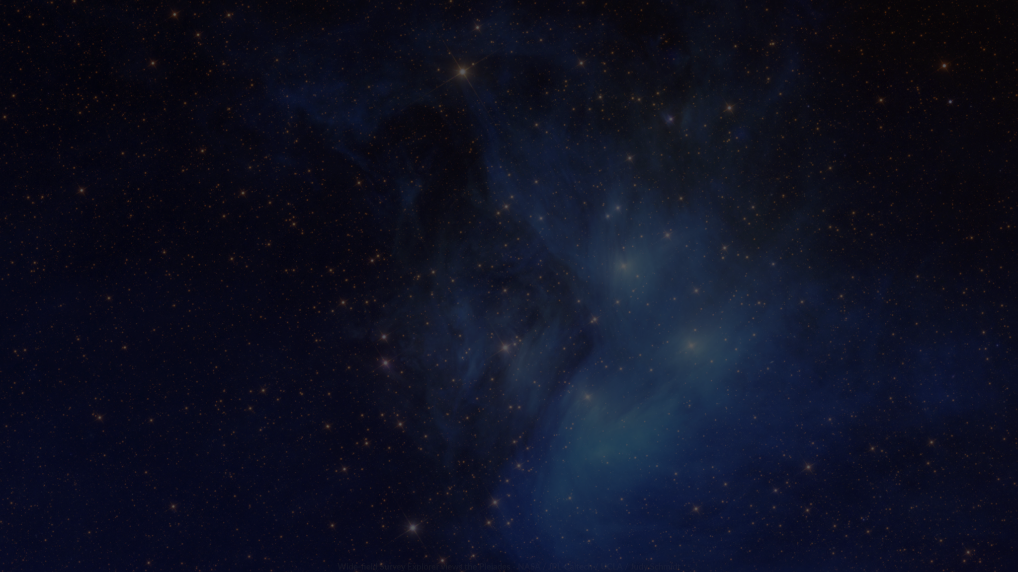
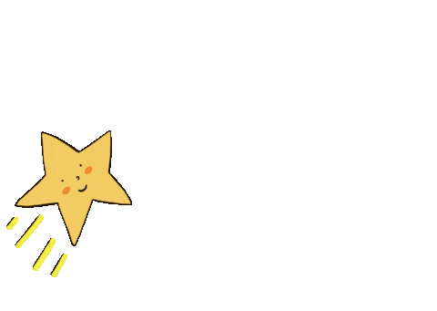
Shoot for the Stars
Stellarverse Studio

Slide 2

On the Team
Rae Fu
3D Artist and Tech Artist
Anastasia Hinton
Renee Bauer
Audio, UX, Producer, Programming
Level Design, Concept Art, Character Art, 3D Modeling
Ethan Baxter
Programming and Integration

Slide 3
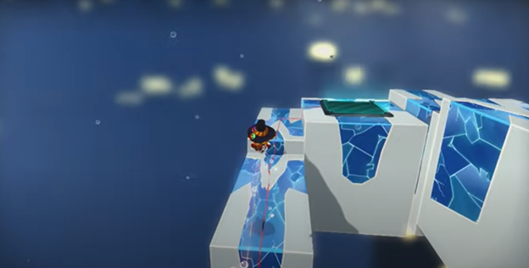
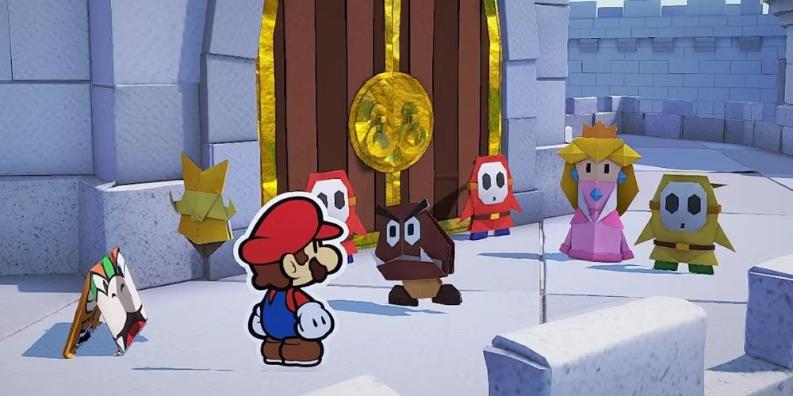
Elevator Pitch: Shoot for the Stars
Our game is a third person platformer with 2D cartoonish characters in a stylized 3D environment. The player is tasked with retrieving lost stars and returning them to their respective constellations. For each star returned, the player gets a small buff to their stats and more story will be revealed. Explore the world with a grapple hook, low gravity and jump pads while avoiding a variety of enemies. The goal of each level will be to safely return the stars without falling or dying.
Inspiration from : Paper Mario and A Hat in Time

Slide 4
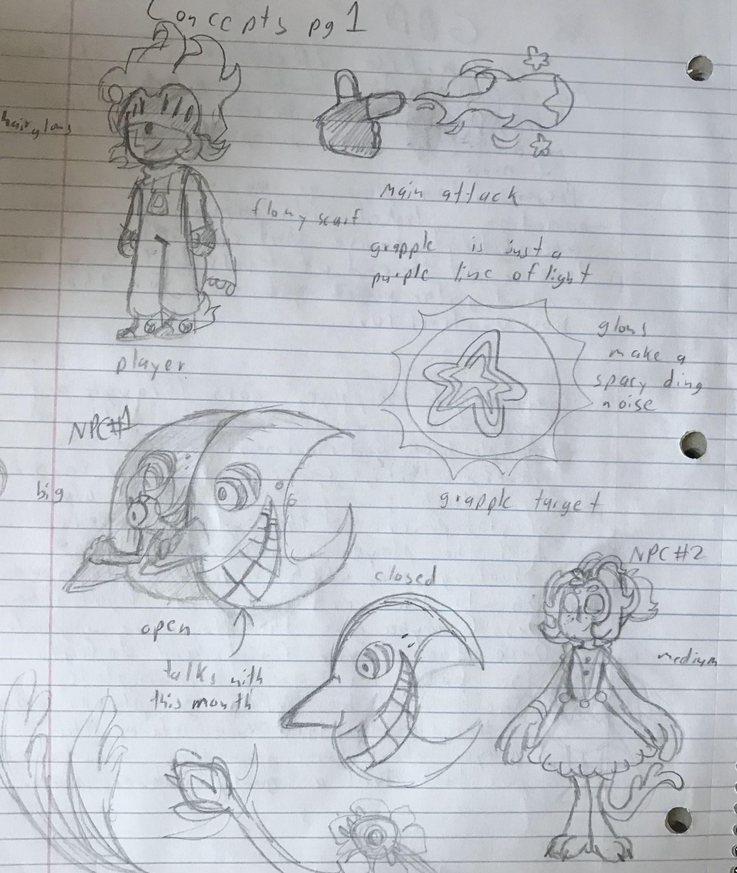
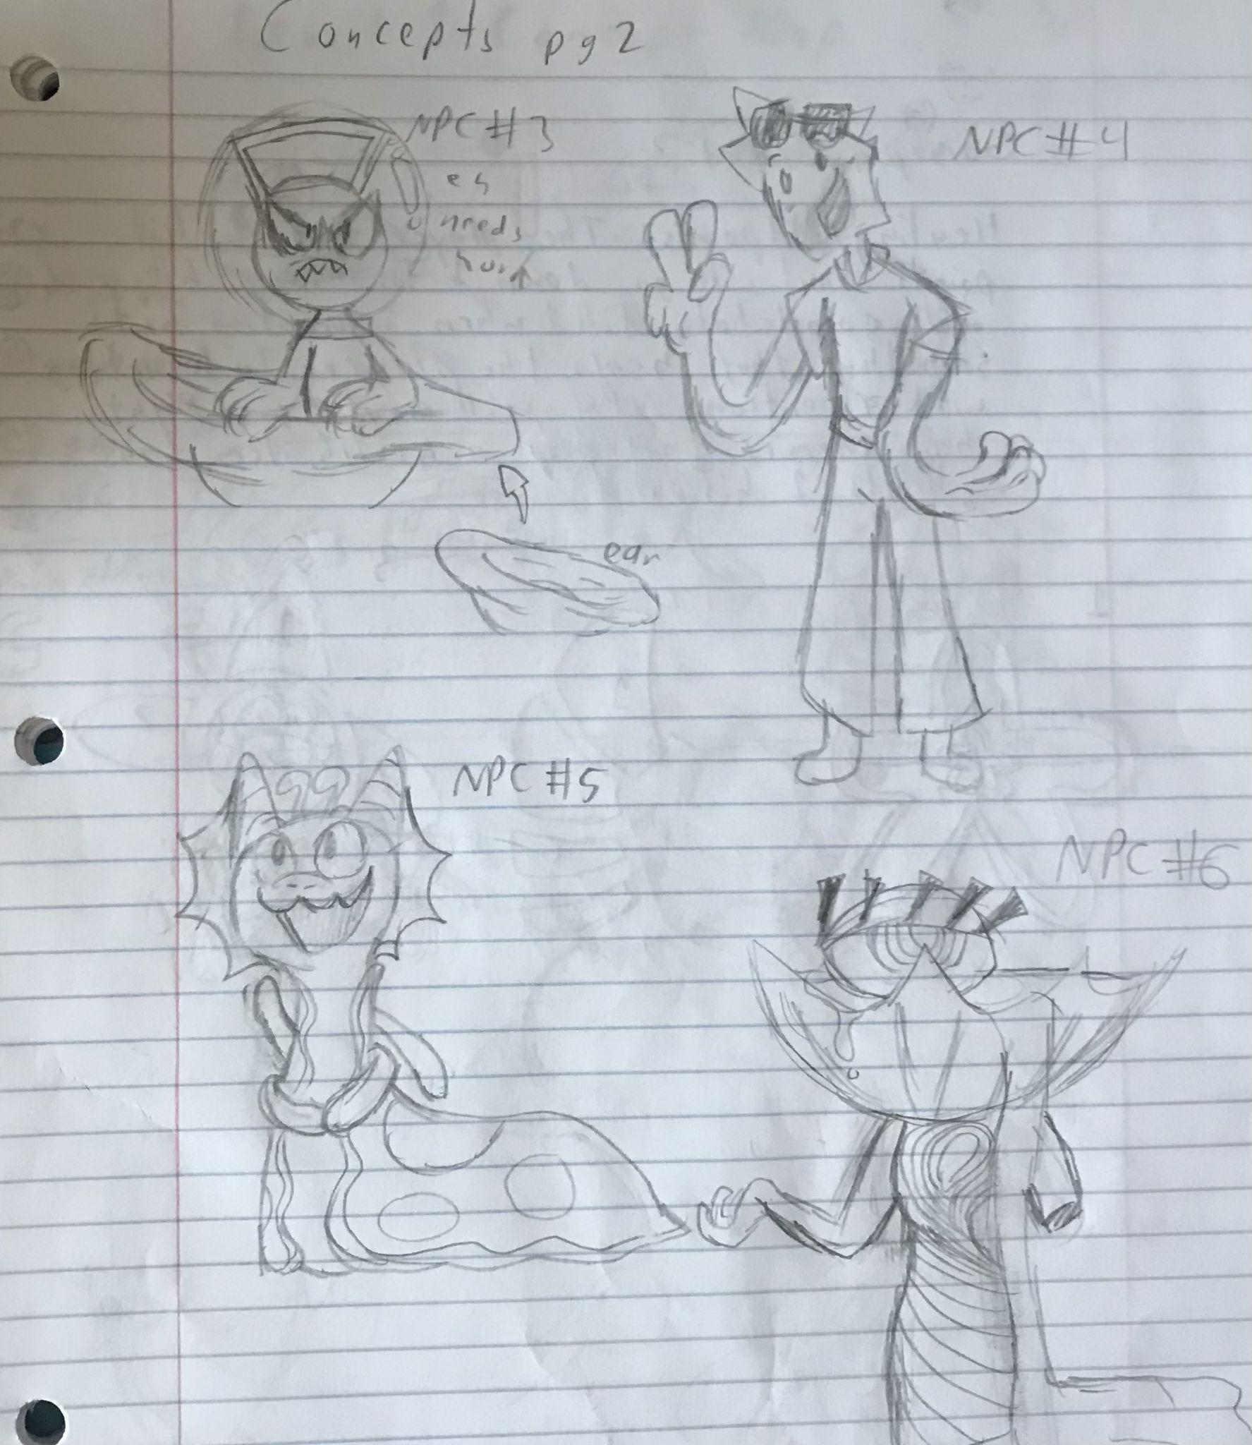
Concept Art

Slide 5

Vision for the Semester
Essentials:
1 fully designed and arted long level
Movement items/abilities
UI/Audio
Creatures/enemies
Animated protagonist
Additional:
3 levels with a boss fight
Each level having a unique mechanic
Animated npc’s
Respawn points
Dialogue + Lore
Plan to release on Steam

Slide 6











Production Pipeline
Software
Unreal Engine 5.3
Github
Confluence for documentation
Jira
Unreal Engine 5.3
Github
Blender
Audacity
Procreate
Maya
Substance Suite
Photoshop + Illustrator
Houdini

Slide 7
THANK YOU!

